Slide 1

Bhagwan Mahavir College Of Computer Application
Subject : Seminar
Topic : Cloud Computing
Guided by :
Asst.Prof.Kruti Patel
Presentnted by :
Savani Jeel.
(2102020101738)

Slide 2
Table Of Content
About My Self.
About Cloud Computing.
Defination.
Type Of Cloud Computing
Assess Needs and Requirements
Select Cloud Service Model
Choose Cloud Provider
Set Up Account and Access
Provision Resources
Deploy Applications or Workloads
Monitor and Manage Resources
Ensure Security and Compliance
Backup and Disaster Recovery
Refrence

Slide 3
About My Self
Hello everyone, My name is Savani Jeel A.
Currently, I'm enrolled in the 6th semester of BCA at BMCCA.
My enrollment number is 2102020101738.
I'm delighted to participate in today's seminar.
Throughout my academic journey, I've developed a keen interest in Web Development.
Thank you for giving me this great opportunity for study in bmcca for bca.

Slide 4
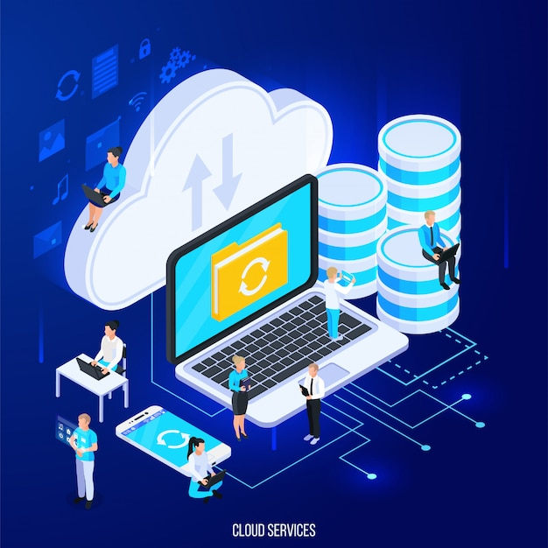
Cloud computing is about how you do computing, not where you do computing." - Paul Maritz

Slide 5
About Cloud Computing
Cloud computing revolutionizes the way businesses access and manage computing resources. By leveraging virtualization and on-demand self-service, cloud computing enables users to provision computing resources such as servers, storage, and applications over the internet, without the need for upfront investment in hardware or infrastructure
With its elasticity, scalability, and metered billing, cloud computing allows organizations to dynamically scale resources based on demand while optimizing costs. Additionally, cloud computing offers high availability, fault tolerance, and robust security measures, making it a reliable and cost-effective solution for storing, managing, and processing data in today's digital age.

Slide 6
Defination
Cloud computing is a technology paradigm that involves delivering various computing services, including servers, storage, databases, networking, software, and analytics, over the internet on a pay-per-use or subscription basis.
nstead of owning and maintaining physical hardware and infrastructure, users can access and utilize computing resources remotely from cloud service providers, enabling greater flexibility, scalability, and cost-efficiency.

Slide 7
Defination
Cloud computing is a technology paradigm that involves delivering various computing services, including servers, storage, databases, networking, software, and analytics, over the internet on a pay-per-use or subscription basis.
nstead of owning and maintaining physical hardware and infrastructure, users can access and utilize computing resources remotely from cloud service providers, enabling greater flexibility, scalability, and cost-efficiency.

Slide 8
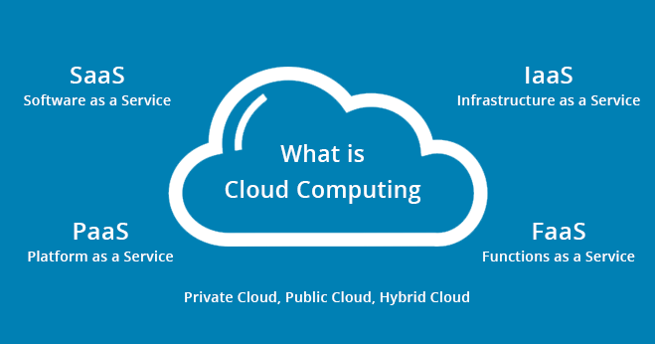
Type of Cloud Computing

Slide 9
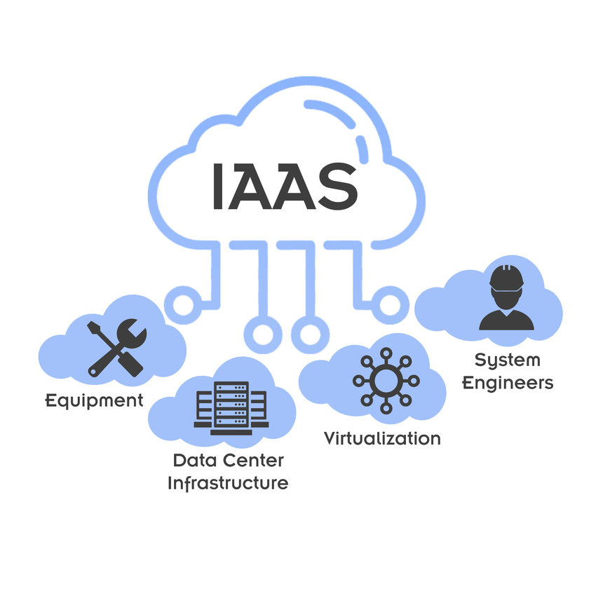
Infrastructure as a Service (IaaS)
Provides virtualized computing resources over the internet, including virtual machines, storage, and networking.
Users have control over the operating systems, applications, and middleware running on the infrastructure.
Examples: Amazon Web Services (AWS) EC2, Microsoft Azure Virtual Machines, Google Compute Engine.

Slide 10
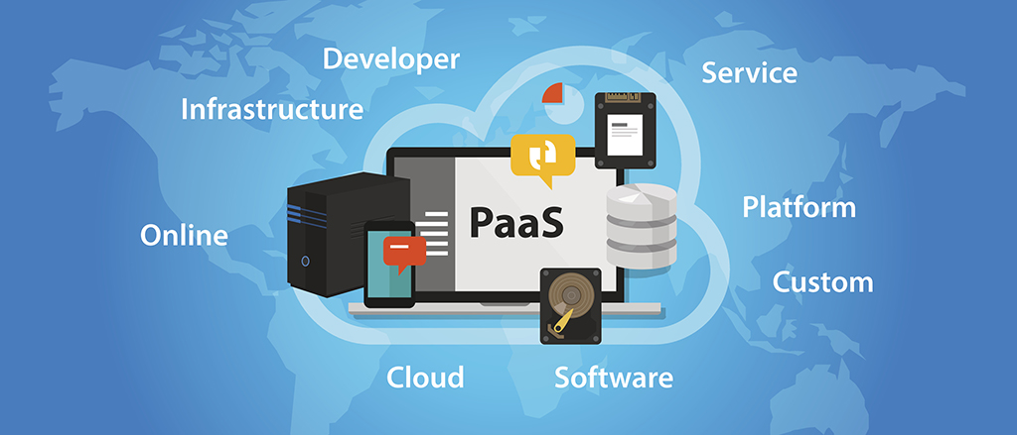
Platform as a Service (PaaS)
Offers a platform allowing customers to develop, run, and manage applications without the complexity of infrastructure management.
Developers can focus on building and deploying applications without worrying about underlying infrastructure.
Examples: Google App Engine, Microsoft Azure App Service, Heroku.

Slide 11
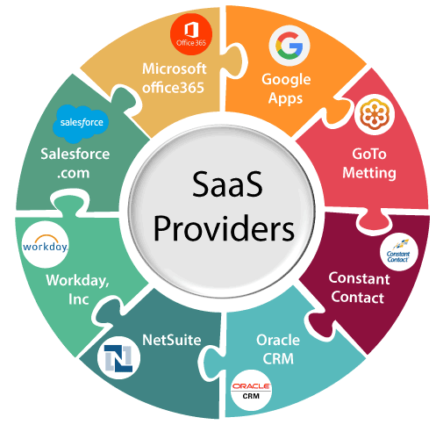
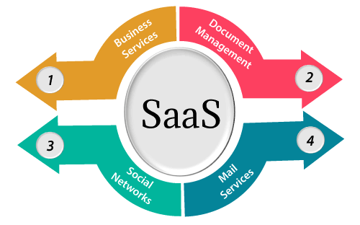
Software as a Service (SaaS)
Delivers software applications over the internet on a subscription basis.
Users access applications through web browsers or APIs without needing to install, manage, or update the software locally.
Examples: Google Workspace (formerly G Suite), Microsoft Office 365, Salesforce, Dropbox.

Slide 12
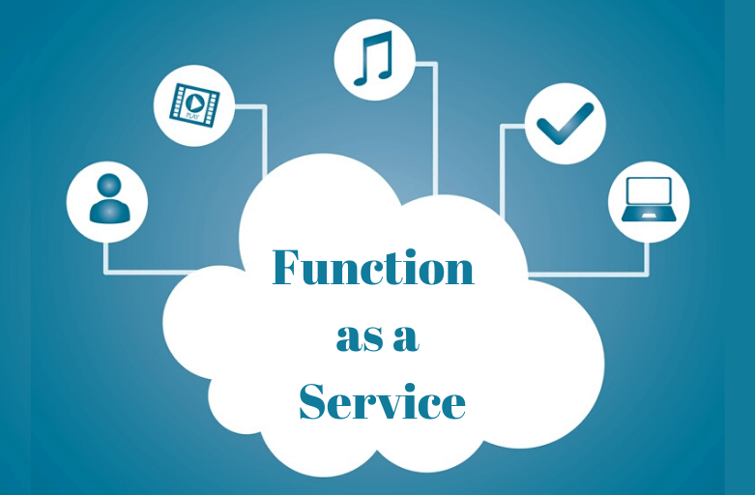
Function as a Service (FaaS)
Allows developers to deploy individual functions or pieces of code in response to events without managing server infrastructure.
Functions are executed in stateless containers and automatically scaled based on demand.
Examples: AWS Lambda, Azure Functions, Google Cloud Functions.

Slide 13
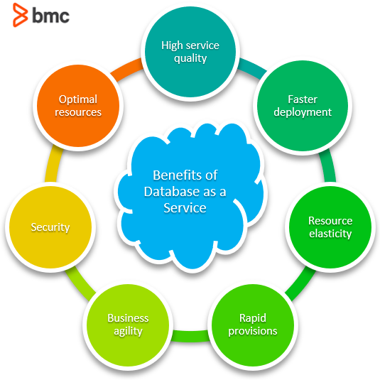
Database as a Service (DBaaS)
Provides managed database services over the internet, including database creation, maintenance, and scaling.
Users can access databases through standard interfaces without managing underlying hardware or software.
Examples: Amazon RDS, Azure SQL Database, Google Cloud SQL.

Slide 14
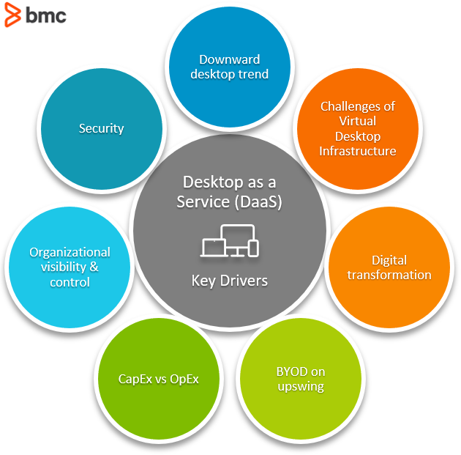
Desktop as a Service (DaaS)
Delivers virtual desktop environments over the internet, allowing users to access their desktops and applications from any device.
Provides centralized management, security, and scalability for desktop environments.
Examples: Amazon WorkSpaces, VMware Horizon Cloud, Citrix Virtual Apps and Desktops.

Slide 15
Assess Needs and Requirements
Identify the specific computing needs and requirements of your organization or project. Determine what types of resources (e.g., computing power, storage, applications) are required to support your goals.

Slide 16
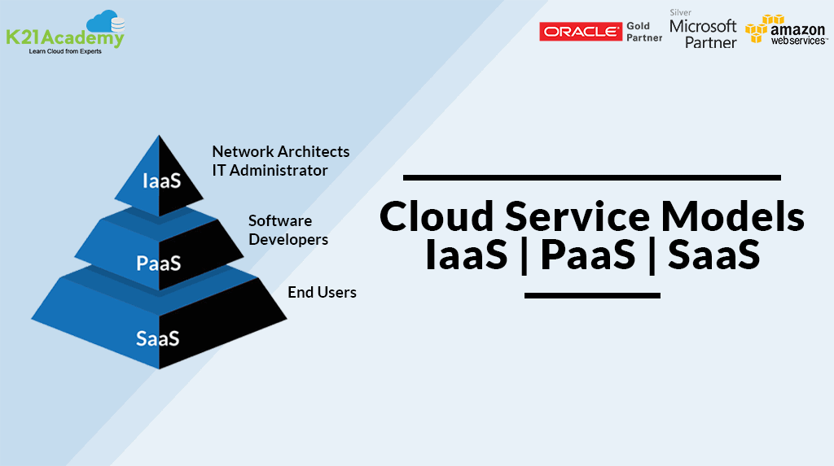
Select Cloud Service Model
Infrastructure as a Service (IaaS): If you need control over the infrastructure and want to manage the operating systems, middleware, and applications.
Platform as a Service (PaaS): If you want to focus on application development without managing infrastructure.
Software as a Service (SaaS): If you want to access pre-built software applications without worrying about installation or maintenance.

Slide 17
Choose Cloud Provider
Select a cloud service provider that offers the desired services, features, and pricing models. Consider factors such as reliability, security, scalability, and cost-effectiveness.
Popular cloud providers include Amazon Web Services (AWS), Microsoft Azure, Google Cloud Platform (GCP), and others.

Slide 18
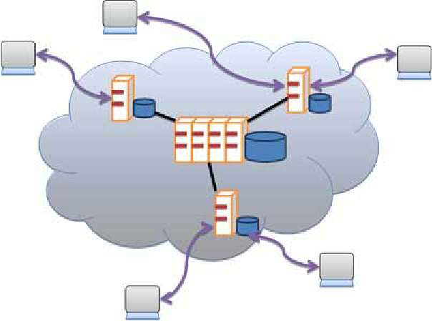
Set Up Account and Access
Create an account with the chosen cloud provider and set up access credentials.
Depending on the provider, you may need to configure permissions, security settings, and billing preferences.

Slide 19
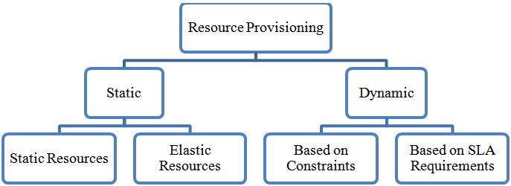
Provision Resources
Use the cloud provider's management console, command-line interface (CLI), or application programming interfaces (APIs) to provision computing resources such as virtual machines, storage, databases, and networking.
Specify the desired configurations, including computing power, storage capacity, and network settings.

Slide 20
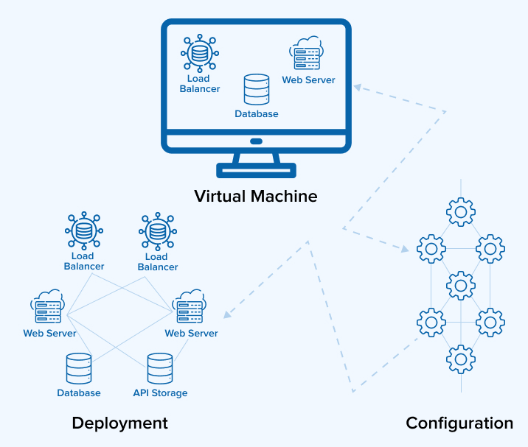
Deploy Applications or Workloads
Deploy your applications, workloads, or data onto the provisioned cloud resources.
Depending on your chosen cloud service model, you may need to install and configure software, develop and deploy applications, or simply access pre-built software applications.

Slide 21
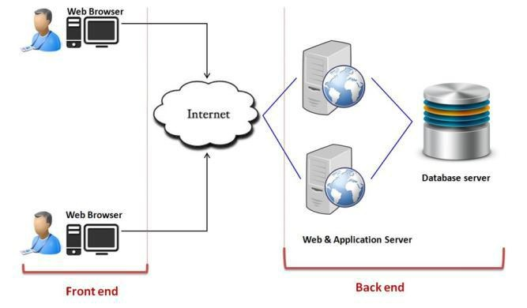
Monitor and Manage Resources
Monitor the performance, availability, and utilization of your cloud resources using built-in monitoring tools or third-party monitoring solutions.
Manage resources dynamically by adjusting configurations, scaling resources up or down, and optimizing utilization based on demand.

Slide 22
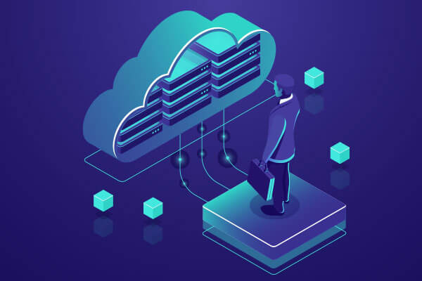
Ensure Security and Compliance
Implement security best practices to protect data and infrastructure in the cloud, including encryption, access controls, identity management, and compliance with industry regulations.
Regularly audit and assess security posture to identify and address potential vulnerabilities or compliance gaps.

Slide 23
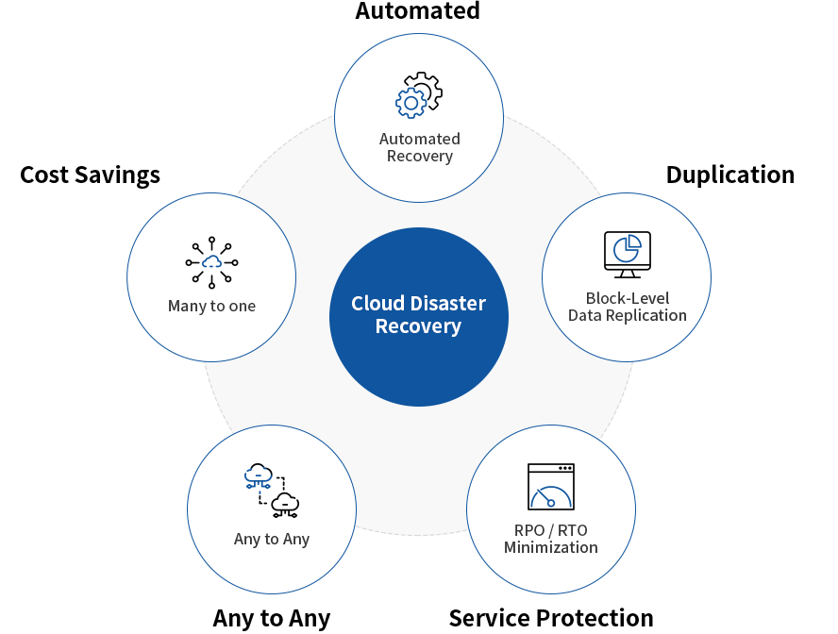
Backup and Disaster Recovery
Implement backup and disaster recovery strategies to protect against data loss and ensure business continuity.
Utilize built-in backup and replication features provided by the cloud provider or integrate with third-party backup solutions.

Slide 24
Refrence
https://en.wikipedia.org/wiki/Cloud_computing
https://cloud.google.com/learn/what-is-cloud-computing

Slide 25
Thank You
Thank you for your time and attention.
In summary, we explored what Is cloud computer and what are the type of it

